Slide 1
Tableau, Power Bi and Mint
By
Akash Chaudhare
19CS002
BE Comp B

Slide 2
Introduction
Tableau, Power BI, and MINT are all business intelligence (BI) tools.
Tableau was founded in 2003, Power BI in 2013, and MINT in 2004.
These tools have been designed to help organizations make data-driven decisions by transforming data into actionable insights.

Slide 3
Tableau, Power BI, and MINT offer a range of features such as data preparation, visualization, reporting, and collaboration.
Each tool has its unique strengths and weaknesses, and the choice of tool depends on the organization's needs, budget, and skill set of the users.
In this presentation, we will compare and contrast the key features of Tableau, Power BI, and MINT to help you make an informed decision on which tool is right for your organization.

Slide 4
Points of Comparison
User Friendly
Data Sources
Data Preparation
Visualization
Dashboards
Collaboration
Pricing and Licensing

Slide 5
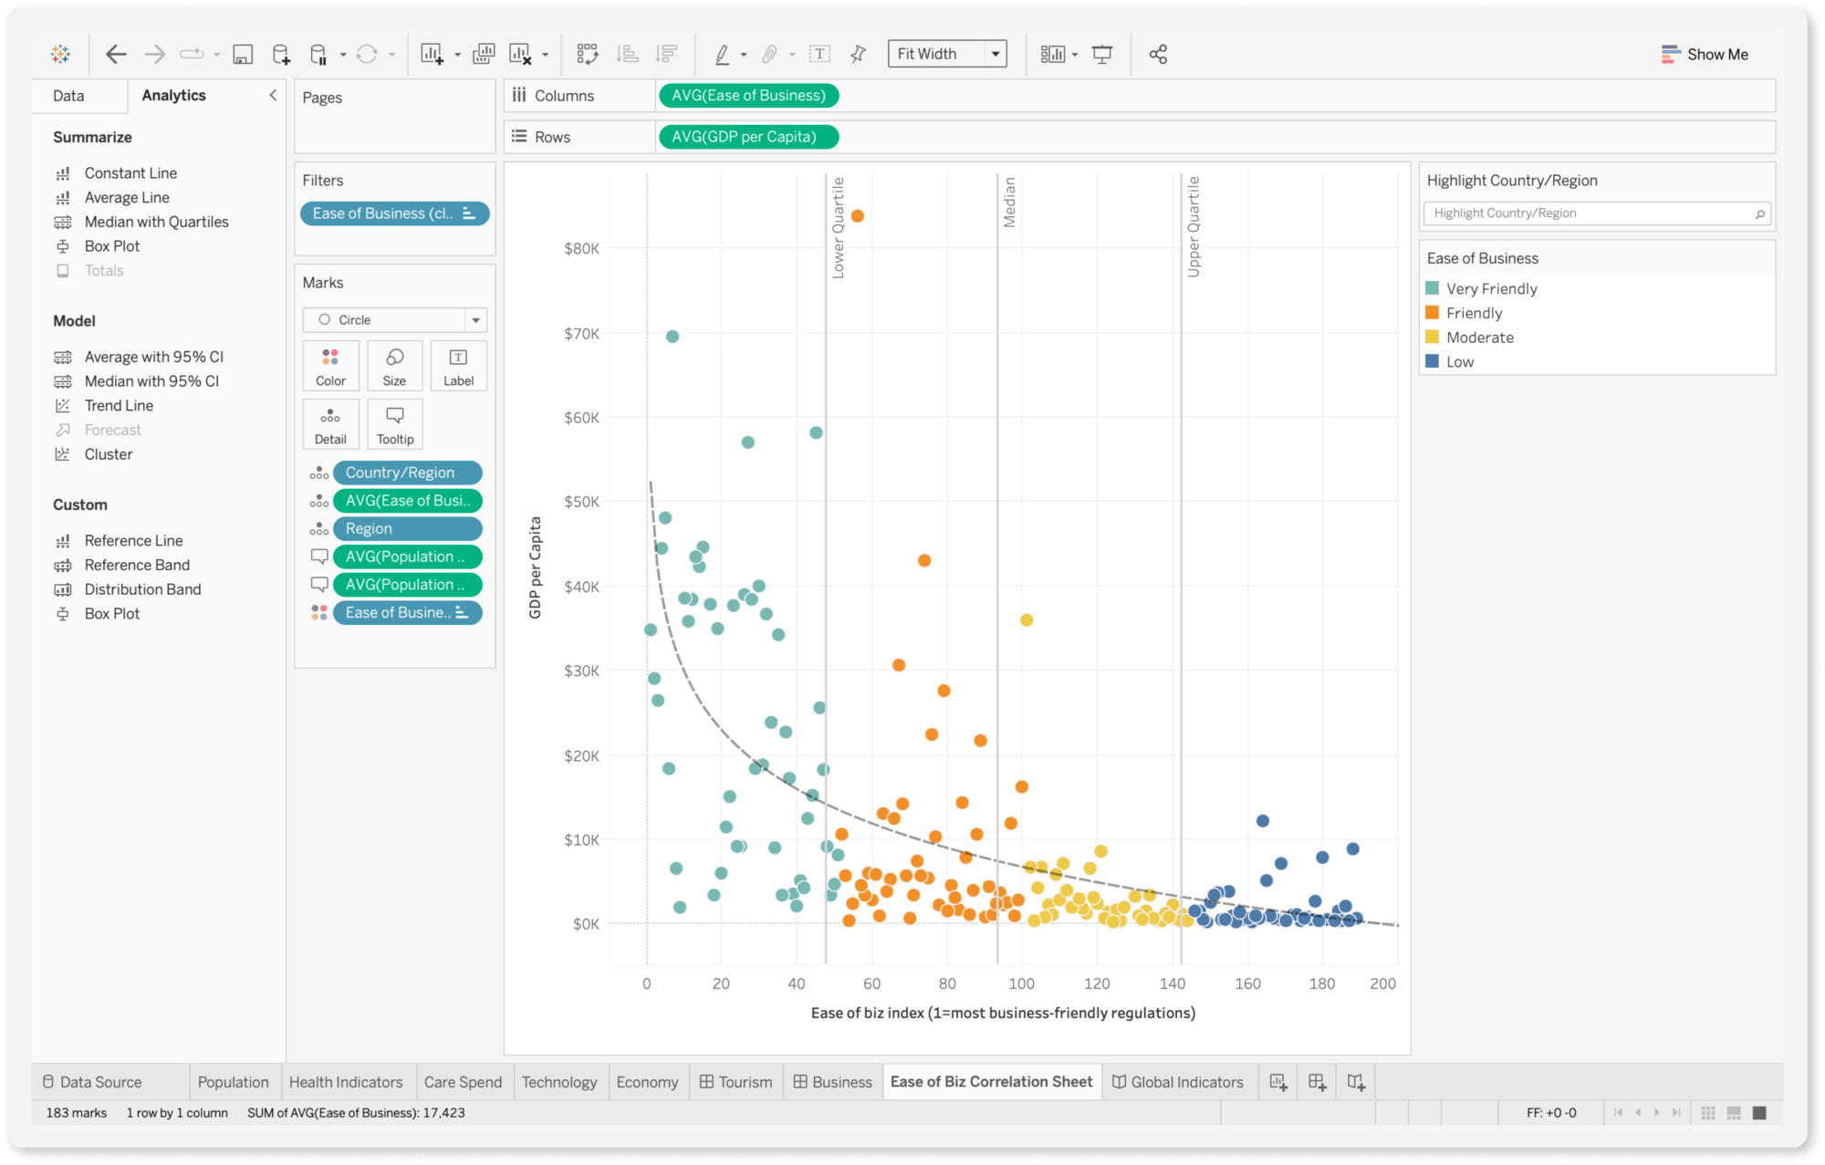
Tableau

Slide 6
Tableau is a data visualization and business intelligence tool that allows users to connect, analyze, and visualize data.
Tableau supports a wide range of data sources, including spreadsheets, databases, cloud-based services, and big data sources like Hadoop and Spark.
Tableau provides a drag-and-drop interface for creating interactive dashboards, which can be customized to meet specific business needs.
Tableau offers a variety of visualization options, including charts, graphs, maps, and tables, making it easy to present data in a meaningful way.

Slide 7
Tableau has a strong community of users who share knowledge and best practices, making it easy for new users to learn and get help.
Tableau offers a range of products, including Tableau Desktop, Tableau Server, and Tableau Online, which provide different levels of functionality and flexibility.
Tableau has a high level of flexibility, allowing users to create custom calculations, use scripting languages like R and Python, and build complex data models.
Tableau has a steep learning curve, but its robust functionality and user-friendly interface make it a worthwhile investment for many organizations.

Slide 8
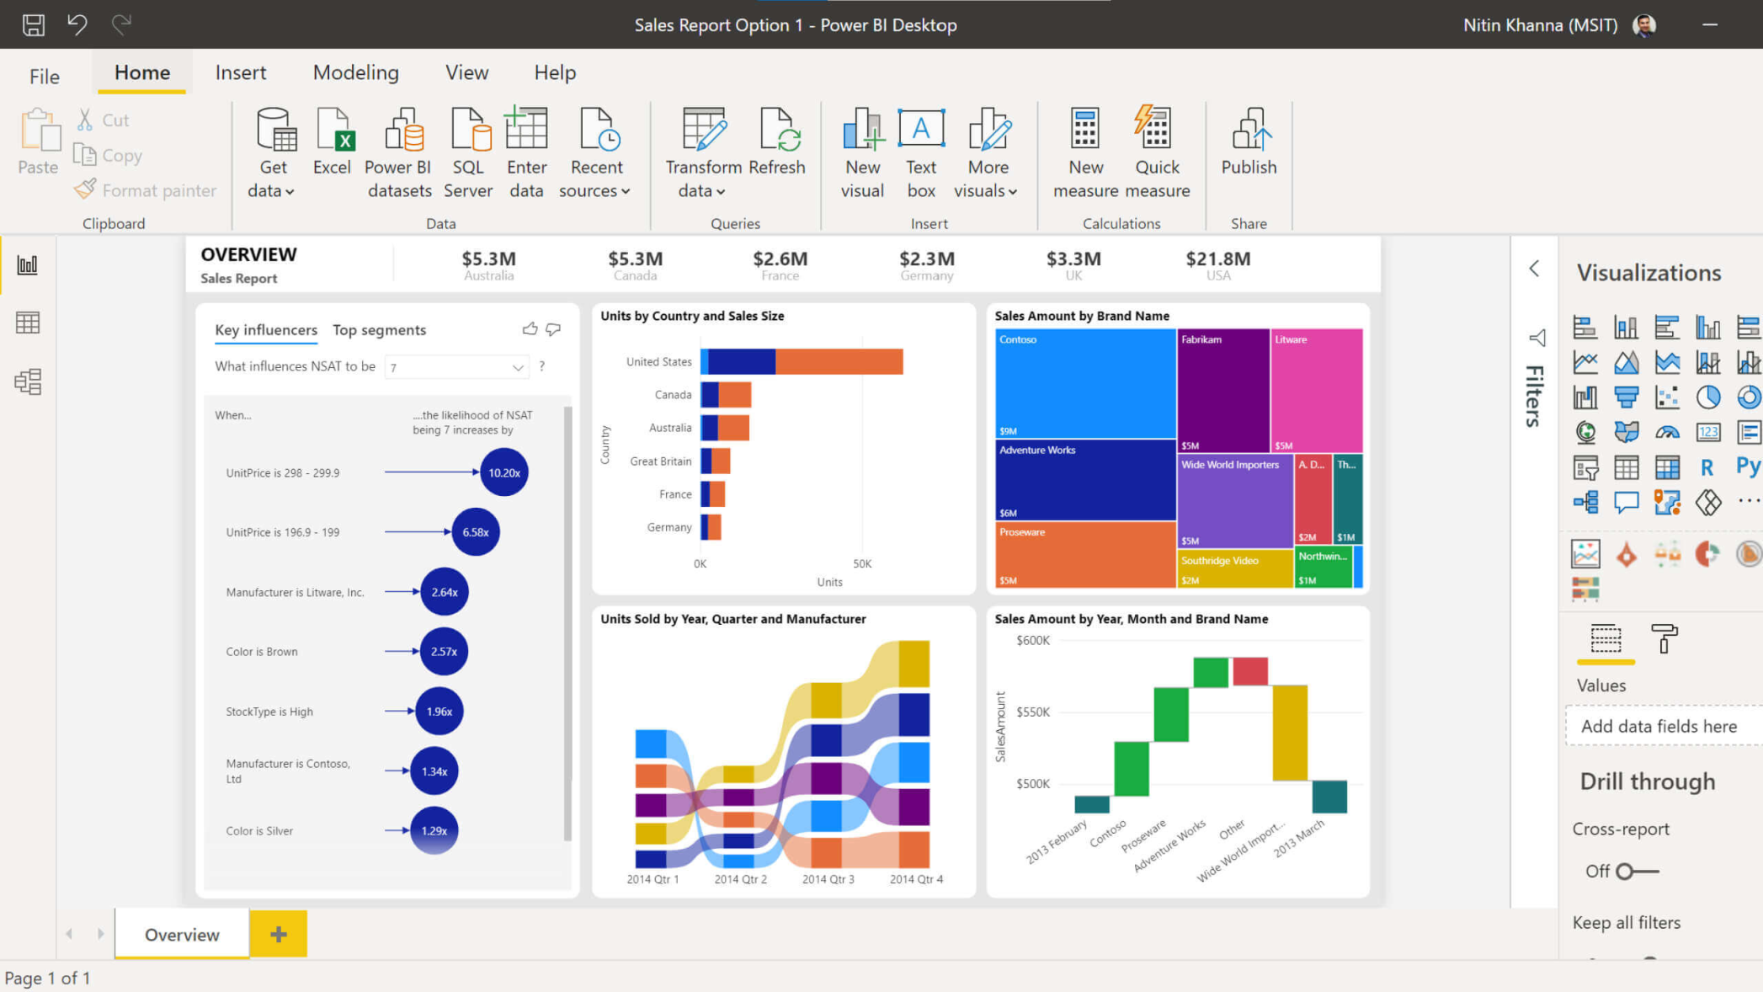
Power BI

Slide 9
Power BI has a user-friendly interface that allows users to create reports and dashboards quickly and easily, with a range of customization options available.
Power BI allows users to create data models using DAX, a powerful formula language that enables complex calculations and data analysis.
Power BI offers a range of visualization options, including custom visuals created by the community, allowing users to present data in a meaningful and engaging way.
Power BI offers a range of collaboration and sharing options, including the ability to share reports and dashboards securely with colleagues and stakeholders.

Slide 10
Power BI integrates seamlessly with other Microsoft products, such as Excel, SharePoint, and Teams, making it easy to incorporate data into existing workflows.
Power BI provides advanced analytics capabilities, such as machine learning and artificial intelligence, which can help users gain insights and make data-driven decisions.
Power BI offers a range of connectors for accessing data from different sources, including cloud-based services like Azure and AWS, making it a versatile tool for data integration and analysis.

Slide 11
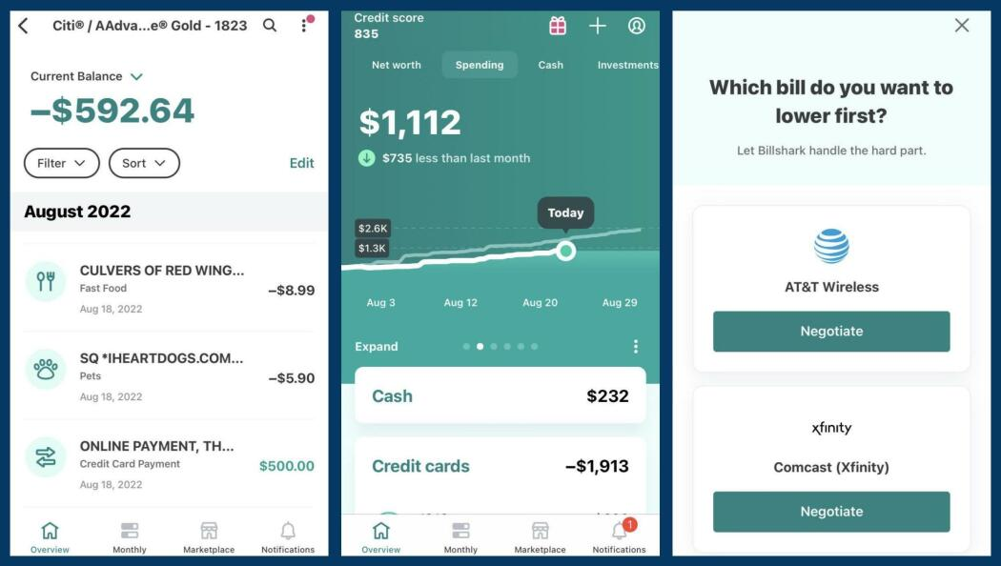
Mint

Slide 12
Mint is a cloud-based financial management tool that allows users to track and manage their personal finances in one place.
Mint automatically pulls in financial data from bank accounts, credit cards, and other financial institutions, allowing users to see their complete financial picture in one place.
Mint provides a dashboard that displays users' financial information, including their account balances, spending, and budgets.
Mint offers tools for categorizing transactions and creating budgets, which can help users track their spending and manage their finances more effectively.

Slide 13
Mint provides alerts and notifications for bill payments, low balances, and other financial events, helping users stay on top of their finances.
Mint has a mobile app that allows users to access their financial information and manage their finances on the go.
Mint is free to use, but the platform generates revenue through targeted advertising and offers for financial products and services.
Mint is a popular choice for personal financial management, but it may not be suitable for users with complex financial needs or for those who are concerned about data privacy and security.

Slide 14
Results
On careful consideration of online reviews and features, we deduce the following

Slide 15
 | Tableau | Power BI | Mint
User Friendly | Least | More | Most
Data Sources | extensive support | extensive support | financial institutions and accounts
Data Preparation | powerful features | powerful features | basic
Visualization | advanced | Less advanced | basic
Dashboards | advanced | advanced | basic
Collaboration | allowing sharing reports and dashboards | allowing sharing reports and dashboards | None
Licensing | Expensive | Cheaper | Free
Specificity | Commercial BI | Commercial BI | Financial Management

